Slide 1
PAYMENT SYSTEM

Slide 2
INTRODUCTION
A Payment System Web Application is a full stack project developed using Java to enable secure and efficient online financial transactions.
It integrates a user-friendly front end with a robust Java-based back end to manage payment processing.
The application supports user authentication, transaction management, and payment validation.
Java technologies such as Spring Boot ensure scalability, security, and reliability of the system.
The front end is built using bootstrap framework of CSS to provides an interactive user experience.
The backend handles business logic, API services, and communication with the database.
A relational database stores user details, transaction records, and payment status securely.
This project demonstrates real-world implementation of full stack development concepts in online payment processing.

Slide 3
PROBLEM STATEMENT
Traditional payment methods are:
Time consuming
Error prone
Require physical presence
Lack transparency
Solution:
This system reduces manual work and provides:
Fast transactions
Secure payments
Easy access anytime
Digital record keeping

Slide 4
OBJECTIVES OF THE PROJECT
To develop a secure online payment platform
To allow users to pay bills easily
To store transaction records safely
To reduce manual work
To provide fast and reliable services

Slide 5
SYSTEM MODULES
User (Customer) Module:
Functions:
User Registration
User Login
View available biller
Select bill category
Make payments
View transaction history

Slide 6
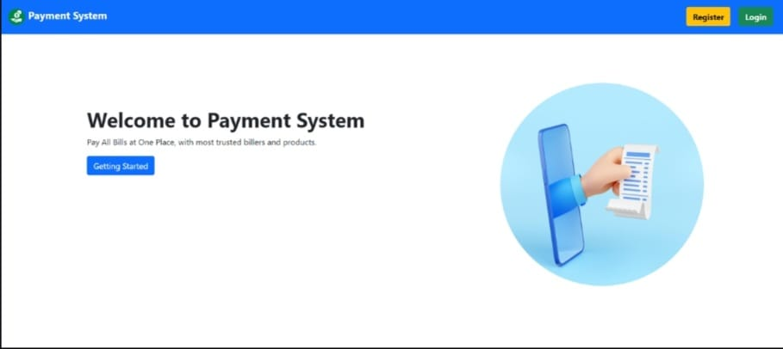
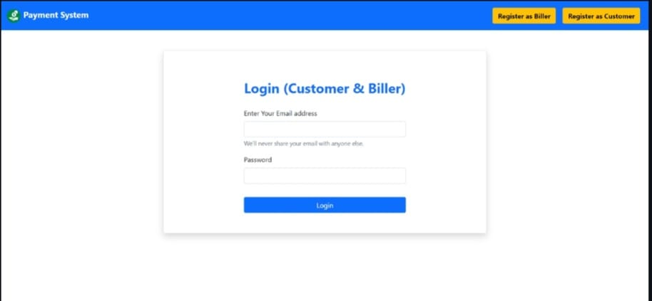
User modules
User registration and login

Slide 7
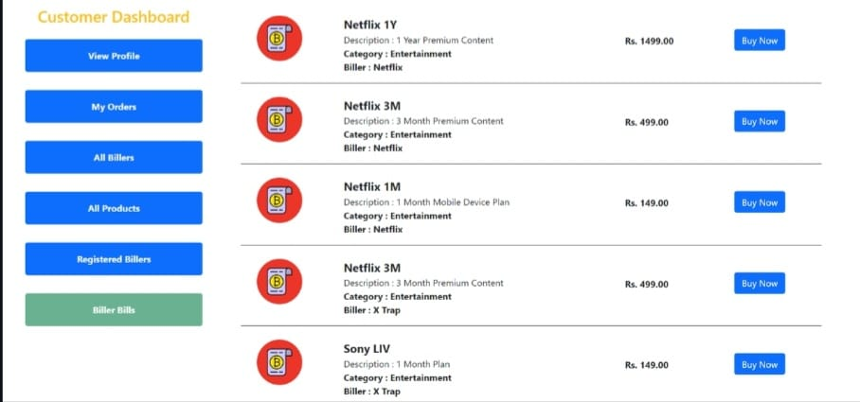
Customer Dashboard

Slide 8
Service-provider(biller) module
Biller Module: This module is for service providers like electricity board, gas agency, etc.
Functions:
Biller Registration
Biller Login
Add products/services
Generate bills
View paid/unpaid bills
Update bill status

Slide 9
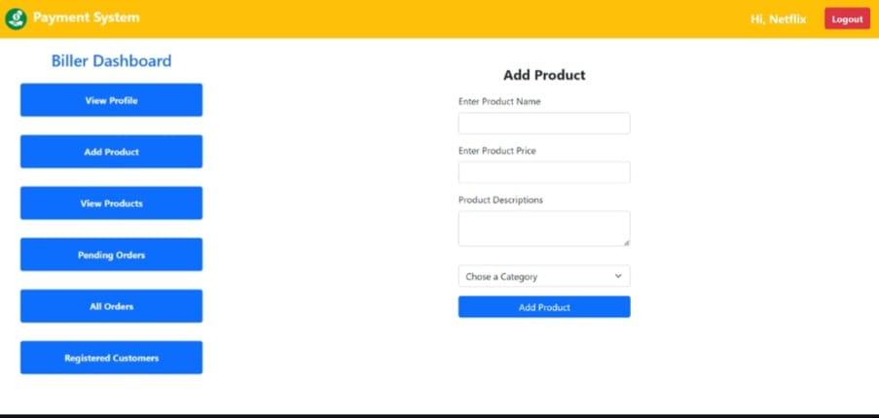
Functions: Biller

Slide 10
TECHNOLOGIES USED:
Frontend:
HTML
CSS
JavaScript
Bootstrap
Backend:
Java
Spring Boot
Database:
MySQL
Tools:
Eclipse
MySQL Workbench

Slide 11
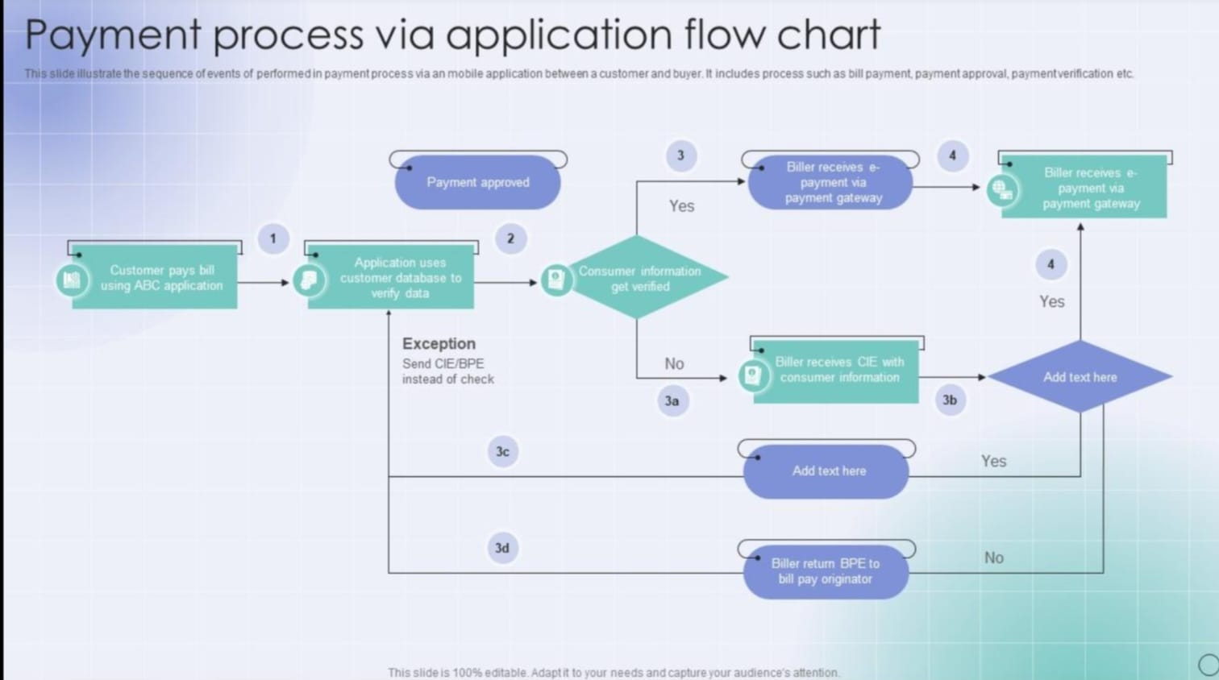
FLOW DIAGRAM

Slide 12
FEATURES:
Secure login system
Real-time payment processing
Bill management
Transaction history
Admin control
ADVANTAGES:
Saves time
Reduces errors
Easy to use
Secure transactions
Paperless system
24/7 availability

Slide 13
APPLICATIONS:
Electricity bill payment
Mobile recharge
Gas bill payment
Insurance payments
Online shopping payments
FUTURE ENHANCEMENTS
Integration with UPI & wallets
AI-based fraud detection
Multi-language support
SMS/Email notifications

Slide 14
CONCLUSION:
The Online Payment System using Java Full Stack provides a secure, fast, and efficient solution for digital payments.
It helps in promoting digital transactions and reduces dependency on manual payment systems.
--THE END--

